Slide 1
COVID-19 Tracking Data Science
May 2020

Slide 2


Hello!
We are Ajay Jayanth and Sarvesh Sathish
We will be juniors in the Computer Science program at the Texas Academy of Math and Science

Slide 3
Background Information: The COVID-19 Epidemic
The uprising of a new respiratory disease “Coronavirus Disease 2019” (abbreviated “COVID-19”) has posed as serious public health risk. Different parts of the world are seeing different levels of COVID-19 activity. The United States has been impacted the most during the pandemic and the disease continues to grow exponentially.
The CDC along with the federal government has been accessing the duration and severity of each pandemic phase. The CDC, state, and local public health have set up laboratories that are testing for the virus that causes COVID-19. Another health guidelines set by the CDC to combat the disease is the quarantine, which has greatly impacted our society.

Slide 4
Project Goals
In light of this COVID-19 epidemic, we have sought for ways we can improve our understanding of the pandemic
We were set with the task of utilizing given COVID-19 datasets to accomplish our goal of understanding the demographics of the epidemic better.
The datasets that we chose to analyze concentrated on the demographic information of the COVID-19 epidemic in the United States, which included demographics on hospitalized people in each states among others.
Then, our aim turned to using the python data science software to answer research questions on the behavior and trends of the epidemic.

Slide 5
Datasets Used in our Data Analysis
The API that we used to retrieve the data from was the public data API on The Covid Tracking Project. The two datasets we used were JSON data on US Historical COVID Dataset and States Current COVID Dataset.
The US Historical COVID Dataset is a JSON dataset of the demographics in the US of the disease on every date since January 22, 2020, the date the disease became trackable in the US. The dataset was accessed through the request URL https://covidtracking.com/api/v1/us/daily.json
The States Current COVID Dataset is a JSON dataset of the demographics of the disease respective to each state and territory in the United States. The dataset was accessed through the request URL
https://covidtracking.com/api/v1/us/daily.json

Slide 6
“There is something fascinating about science. One gets such wholesale returns of conjecture out of such a trifling investment of fact.”
Mark Twain

Slide 7
Data Research Questions
These were the COVID-19-related research questions that we chose to focus our data analysis on.
How has the demographics of Coronavirus patients changed over time in the US?
How is the total number of Coronavirus patients distributed among states in the US?
How have the demographics of the Coronavirus exhibited a ratio of positive to negative test results and a ratio of deaths to confirmed cases?

Slide 8
Data Research Question 1
How has the demographics of Coronavirus patients changed over time in the US?

Slide 9
How is this question important?
In order to understand the impact of the disease in the United States, it is important to understand the trackable demographics of the disease and how they have changed over time. This can help with predictions of the disease’s growth and the understanding of its infectivity and severity.

Slide 10
How did we choose to answer it?
We chose to answer this data research question by extracting data from the US Historical COVID Dataset, cleaning it, configuring it for optimal data analysis, and plotting the significant demographic data over time all in Repl.it using Python and some of its available packages.

Slide 11
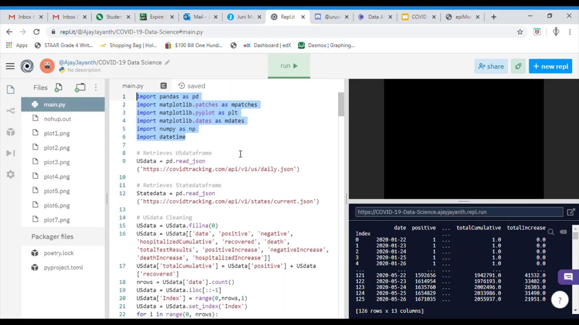
How does the code of this solution look like?

Slide 12
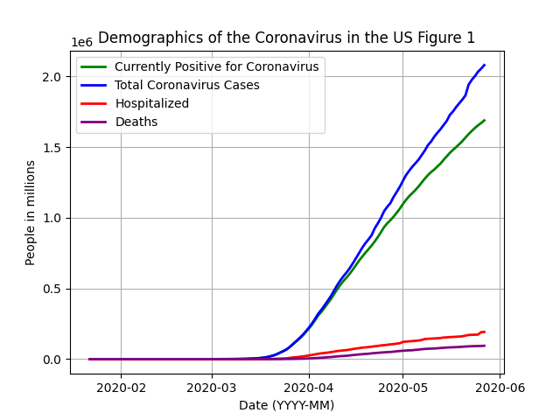
Demographic Trends in the US
According to the figure, the trends of total cases, positive cases, hospitalized cases have seem to increase exponentially in the US and then linearly over time. This makes sense because starting mid-March, the cases began climbing exponentially in the US and once the social distancing and quarantine policies were established, the cases began to increase linearly since mid-April.

Slide 13
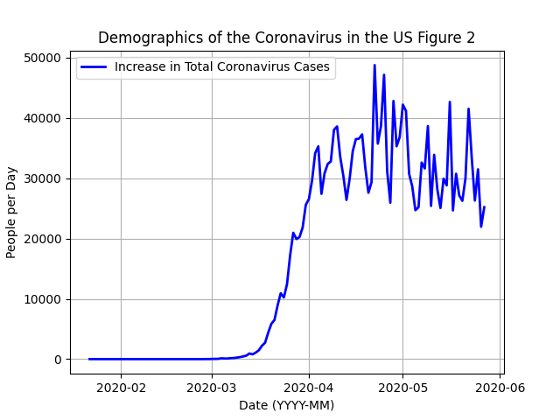
Increase of Cases in the US
According to the figure, the rate of increase of the cases in the US increased steadily from mid-March to the beginning of April, causing the exponential growth in total cases observed earlier, and then stopped to oscillate horizontally from April to the present day, which also explains the linear increase in total cases due to the quarantine and social distancing.

Slide 14
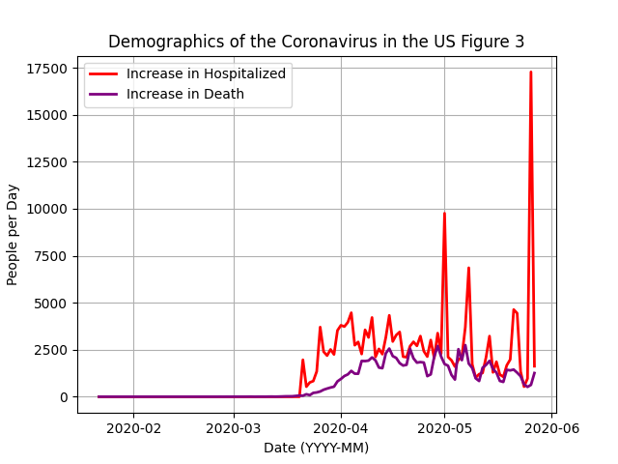
Increase in Secondary Demographics
According to the figure, the increase of people who were hospitalized had spiked significantly during May and June in the United States. However the increase in death slowly began to stabilize and steadily decrease in number.

Slide 15
Recap of Findings from Question 1
Although it was obvious that the cases, hospitalized, deaths, etc would increase over time, we discovered that the rate of increase in the total cases changed drastically after the implementation of social distancing and quarantine around mid-April. We also discovered that the hospitalized cases increased erratically, while the deaths were increasing in a steady and predictable rate.

Slide 16
Data Research Question 2
How is the total number of Coronavirus patients distributed among states in the US?

Slide 17
How is this question important?
This question is important in highlighting the hotspots of this infectious disease in the United States. Finding these hotspots can show which states and regions of our country needs more health care and assistance from the government and other organizations. Distributing assistance to specific struggling states in the US will help alleviate the disease as a whole.

Slide 18
How did we choose to answer it?
We chose to answer this data research question by extracting data from the States Current COVID Dataset, cleaning it, configuring it for optimal data analysis, and plotting the demographic of total cases for each state in the US, while also labeling each state with a region* of the US in Repl.it using Python and some of its available packages.
*The regions were demarcated according to the National Geographic Society Resource Library.

Slide 19
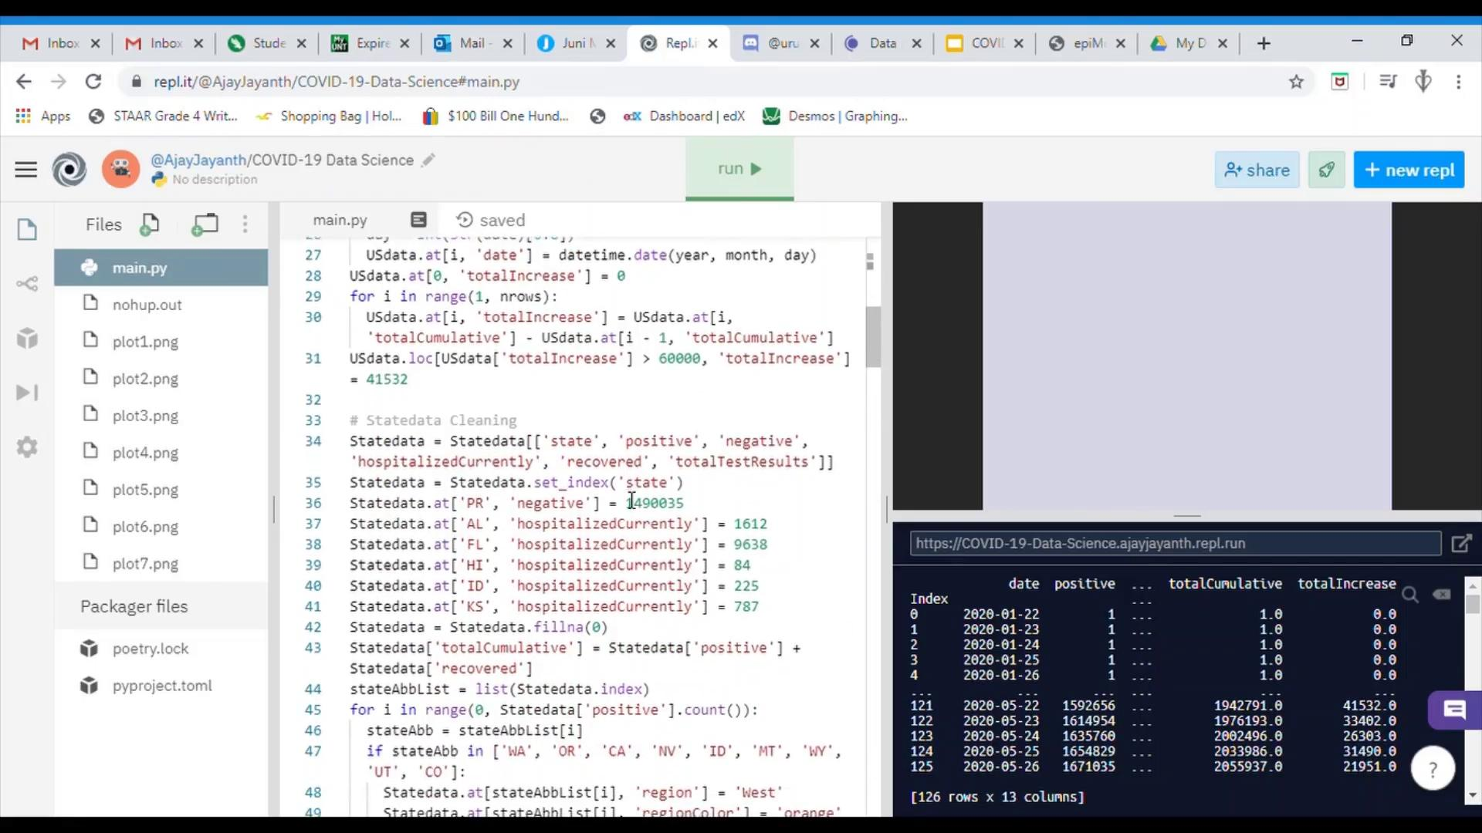
How does the code of this solution look like?

Slide 20
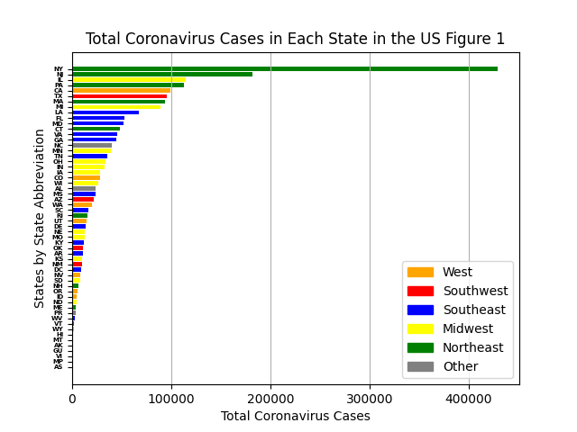
State-Respective Cases: Linear Scale
According to the graph, New York has the most cases of around 420,000, followed by New Jersey, which has less than half of that of New York. It can also be observed that three of the states that have more than 100,000 cases are in the Northeast region, which is the region hit the hardest by the virus.

Slide 21
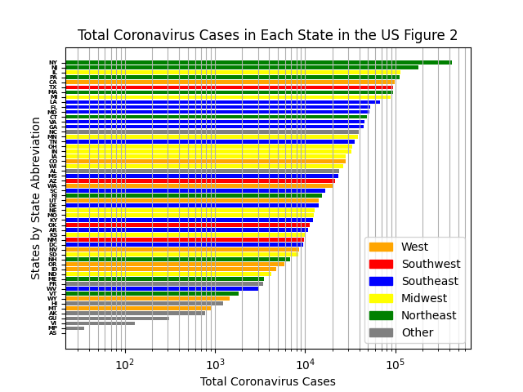
State-Respective Cases: Logarithmic Scale
This is the same figure as the one before but using a logarithmic scale, but now it is more evident that while the Northeast region has hundreds of thousands of cases, the Southeast and Midwest regions are facing a lower order of power or around 1/10 of that of the Northeast Region. Following those regions are the Southwest, the West, and the Others.

Slide 22
Recap of Findings from Question 2
The distribution of cases among the states in the US entertains a phenomena known as Zipf’s Law, where the second most concentrated state has half as many cases as the most concentrated state, the third most concentrated state has a third as many cases as the most concentrated state, and so on and so on. This makes the distribution extremely predictable and means that we can predict which states will need more assistance in the future. Additionally, the eastern regions of the US, especially the northeast has been impacted exponentially more than the rest of the US.

Slide 23
Data research Question 3
How have the demographics of the Coronavirus exhibited a ratio of positive to negative test results and a ratio of deaths to confirmed cases?

Slide 24
How is this question important?
The ratio of positive to negative test cases in the US would show how elusive or prominent a positive case is in a larger pool of COVID-19 test cases. This could also relieve some of the panic because symptoms of the virus are showing in some people may exhibit a negative test result. The ratio of deaths to confirmed cases in the US would show how lethal the disease is and how healthcare could or could not be prioritizing patients with higher risks of death.

Slide 25
How did we choose to answer this question?
We chose to answer this data research question by extracting data from the US Historical COVID Dataset, cleaning it, configuring it for optimal data analysis, and plotting the two ratios in each plot all in Repl.it using Python and some of its available packages. We analysed the graph that resulted from this and came across a conclusion.

Slide 26
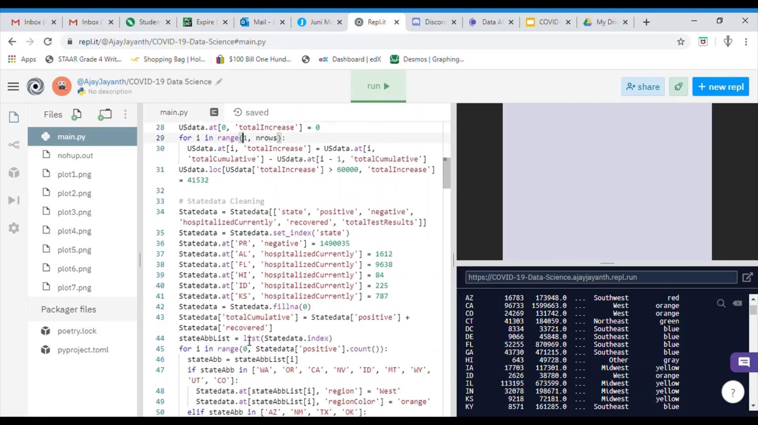
How does the code of this solution look like?

Slide 27
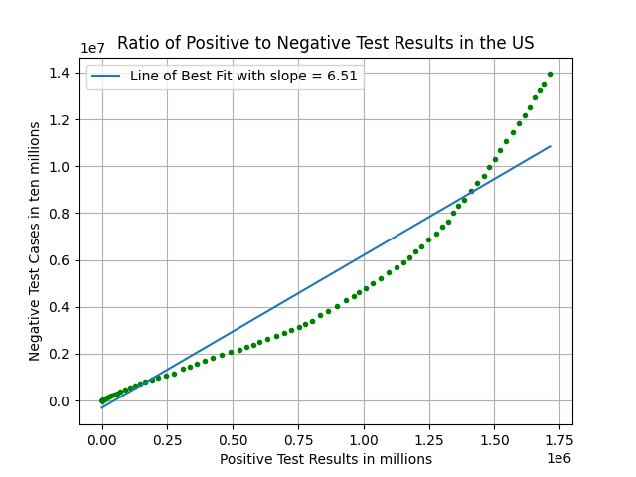
Ratio of Positive to Negative Test Results in the US
According to the graph, the average ratio of positive to negative test results are 1 positive test result to 6.51 negative test results and 1 positive result in 7.51 total test results. The ratio has been decreasing from the origin to around 850,000 positive results, which meant less and less results were exhibiting positive results until the ratio began to rise over the average secant line, which meant more and more test results began to exhibit positive results.

Slide 28
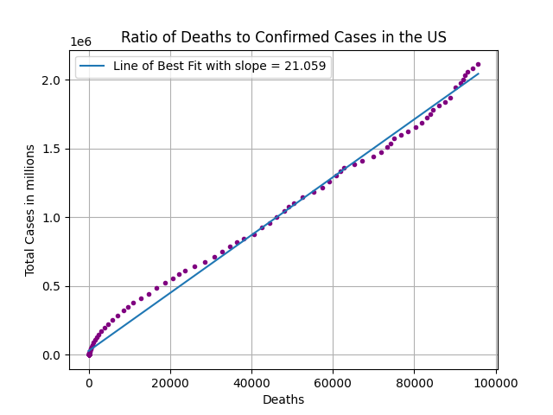
Ratio of Deaths to Confirmed Cases in the US
According to the graph, the average ratio of deaths to confirmed cases is 1 death in 21.059 confirmed cases. It’s clear that ratio between the deaths and confirmed cases is nearly constant as the line of best fit matches the graph well. This means that the death rate is rigid and predictable but also will be difficult to alleviate.

Slide 29
Recap of Findings from Question 3
The ratio of positive cases to negative results have seemed to decrease until it hit 850,000, which happened near the end of April. As mentioned before, this is when social distancing and quarantine were effective in practice in the US, which meant that less people infected others with the disease and the symptoms became more and more predictable for the disease over time. This explains why the ratio of positive to negative results began to increased since then. The ratio of deaths to confirmed cases exhibited a trend that was easily captured by a line of best fit, which meant that the ratio would stay constant as 1 death in every 21.059 confirmed cases.

Slide 30
Thanks!
Any questions?
You can find me at
sarveshsathish.2004@gmail.com
kunhu2004@gmail.com

